Slide 1

ADVANCED WEB DEVELOPMENT PROJECT
Submitted To : Mrs. Vidhu Baggan
Submitted By : Garvit Khunger/2010990990
Rohan Hooda/2010991071
Jaskaran Singh/2010991014
Pushpendra Tripathi/2010991056

Slide 2

Readers beat
Readers Beat has grown into a platform where self-publishing authors have the opportunity to introduce their work to our community and new books are uploaded to our site daily - provided they comply to our quality standards. In our daily newsletter, we keep our rapidly growing list of active subscribers up to date on the latest free and discounted eBooks that are available online. We always love to hear from our visitors, so if you have any questions or feedback, don't hesitate to contact our editor editor@readersbeat.com

Slide 3
1. Home

Slide 4
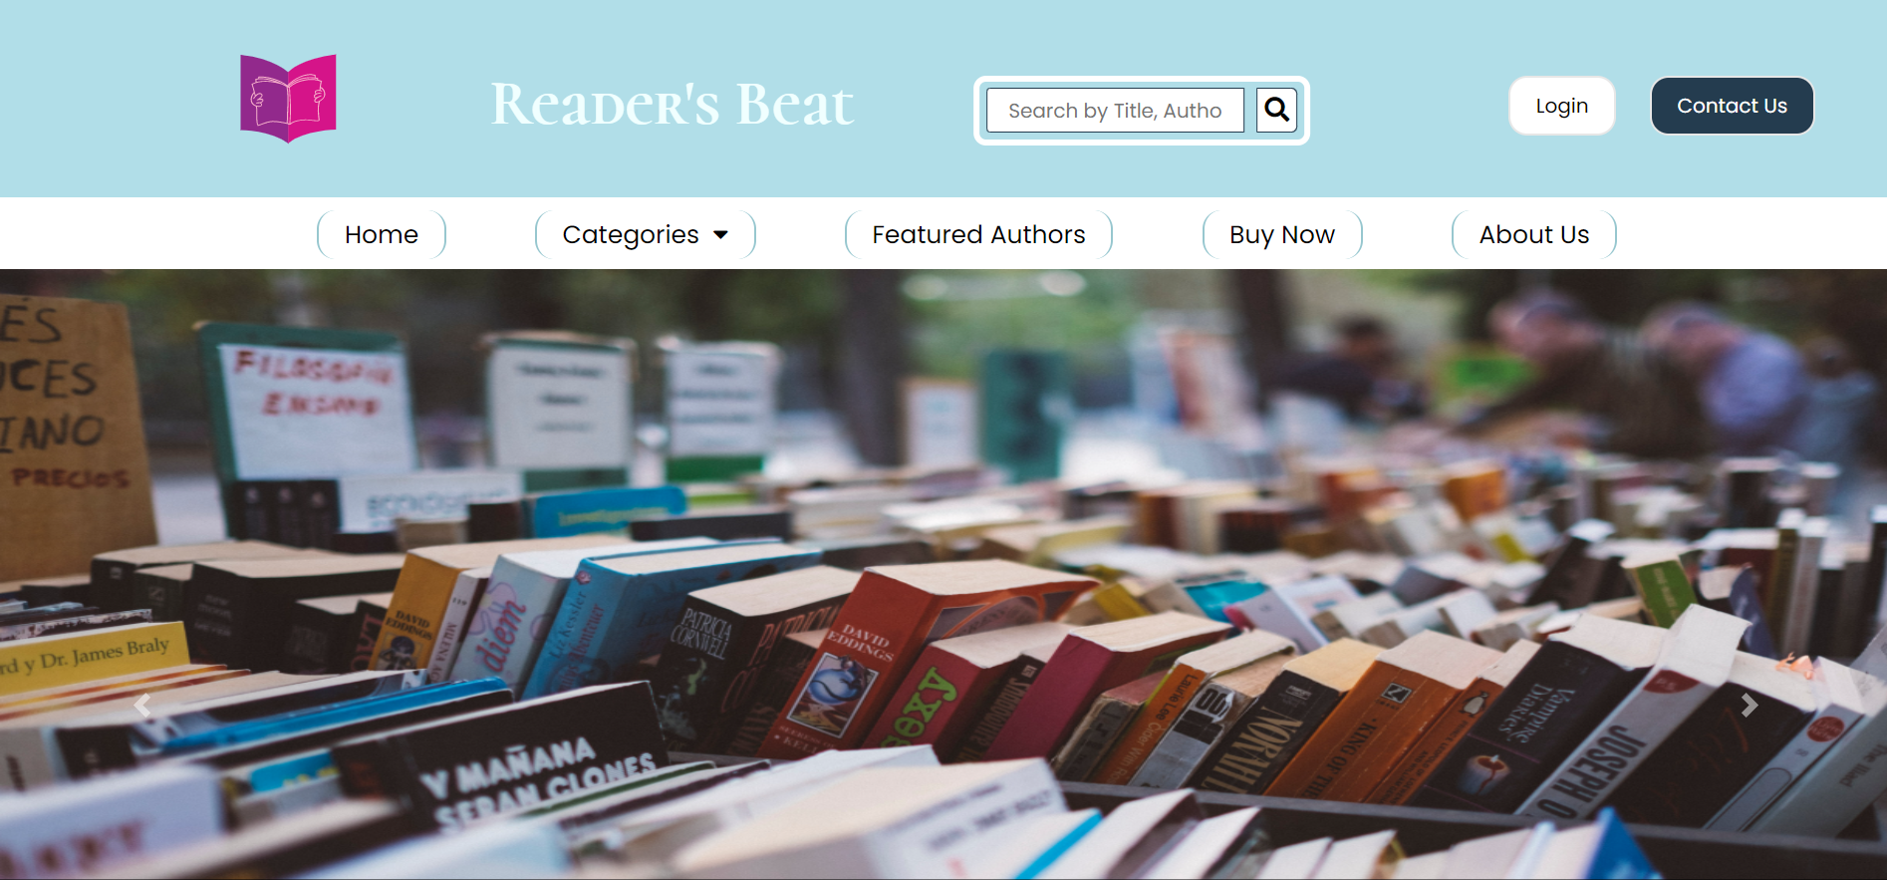
First look

Slide 5
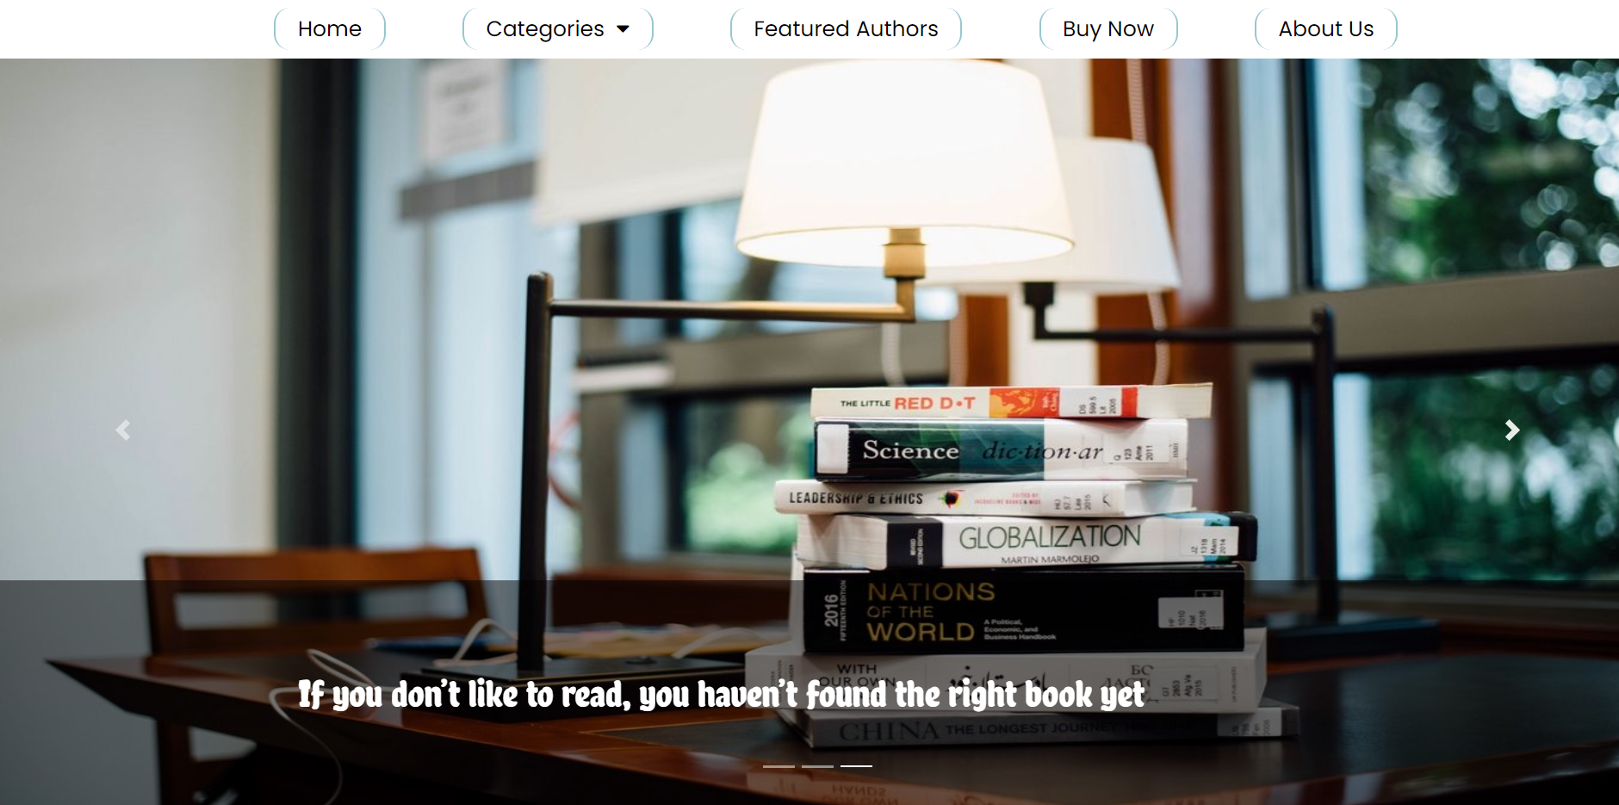
Carousel with sticky nav bar

Slide 6
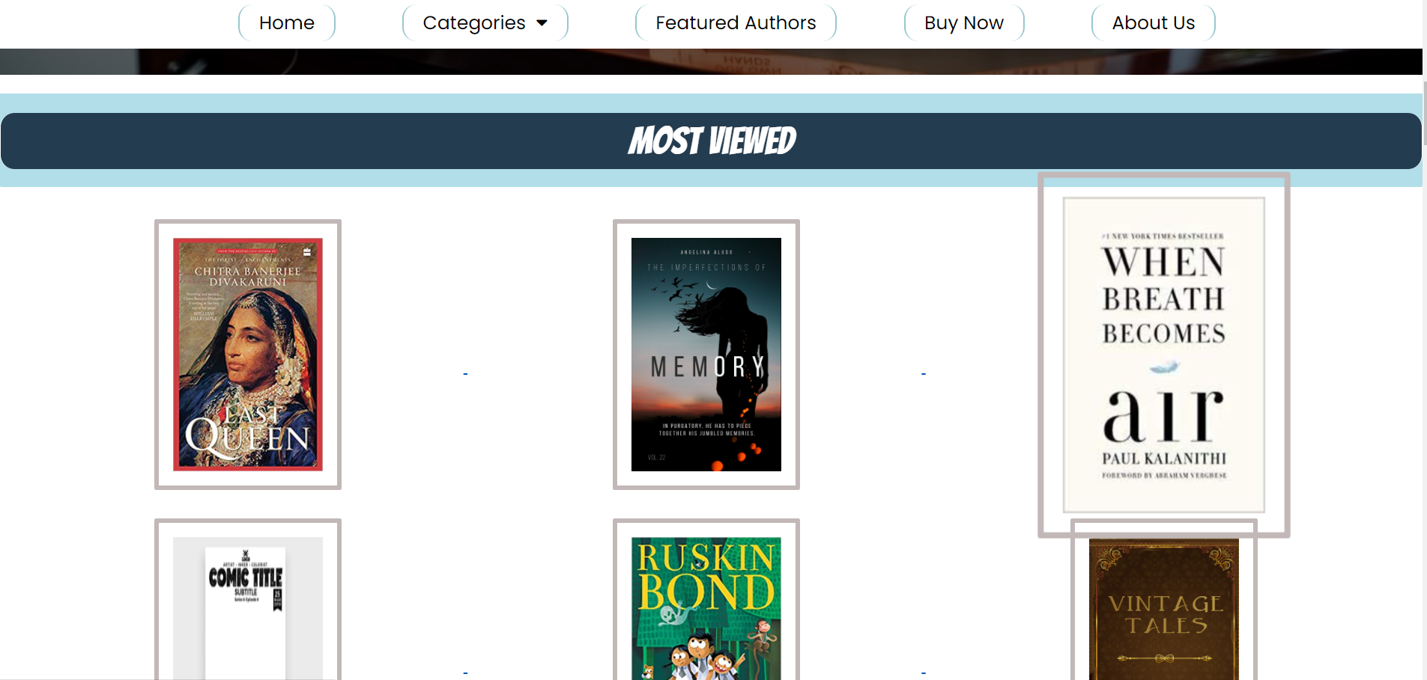
Various sections with small animations

Slide 7
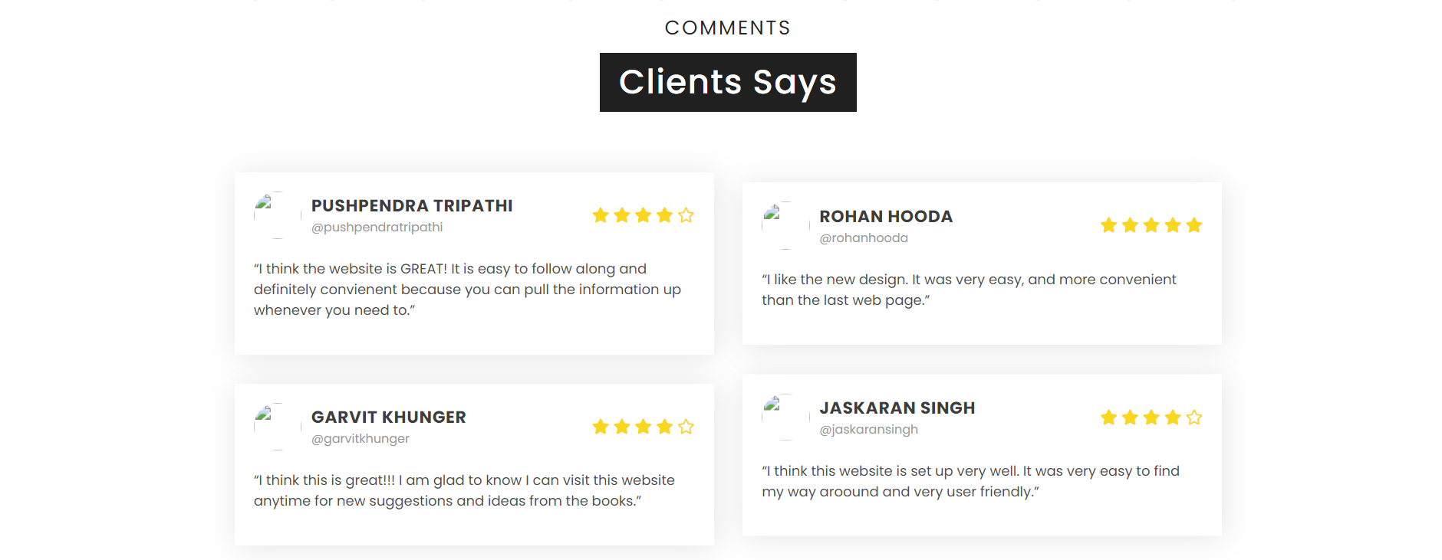
Client comments

Slide 8
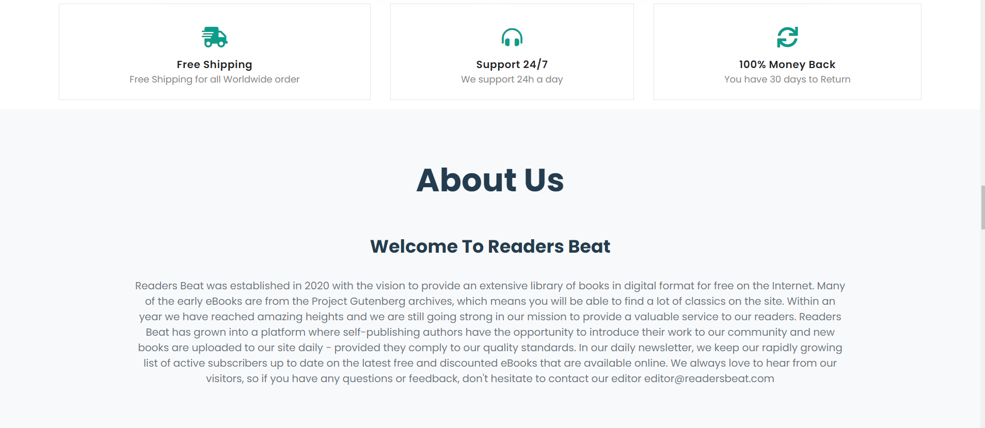
About us

Slide 9
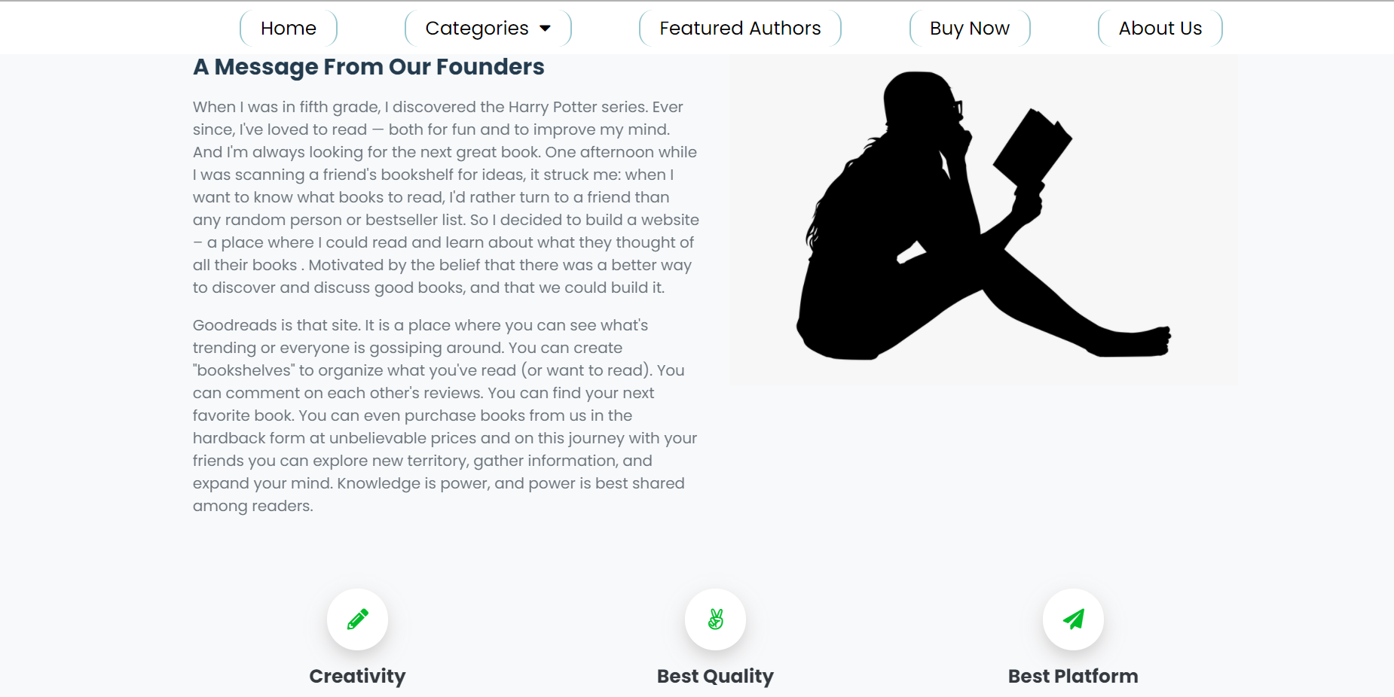
About us

Slide 10
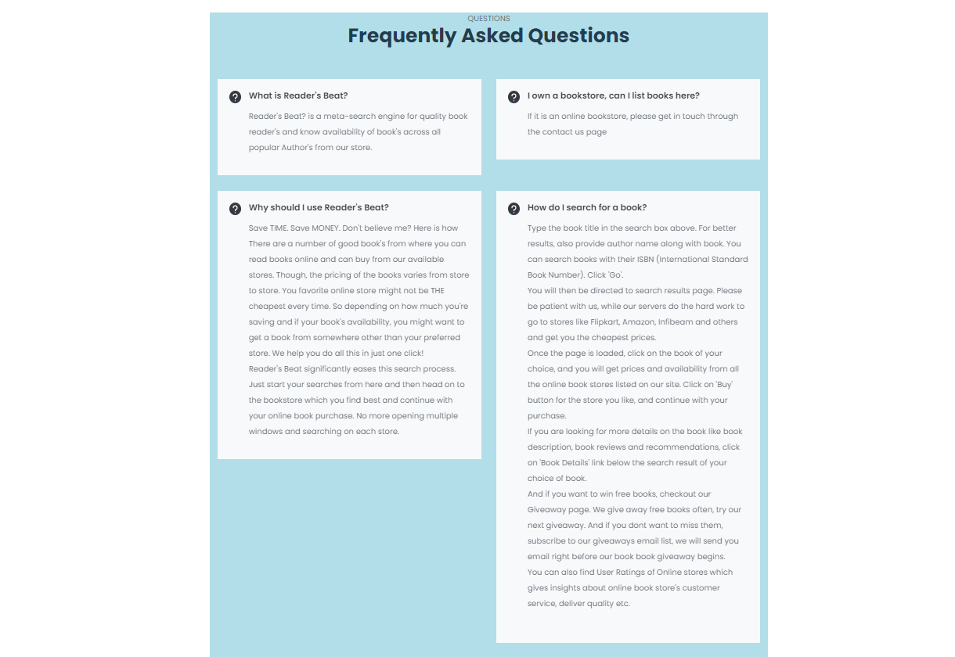
FAQ’S

Slide 11
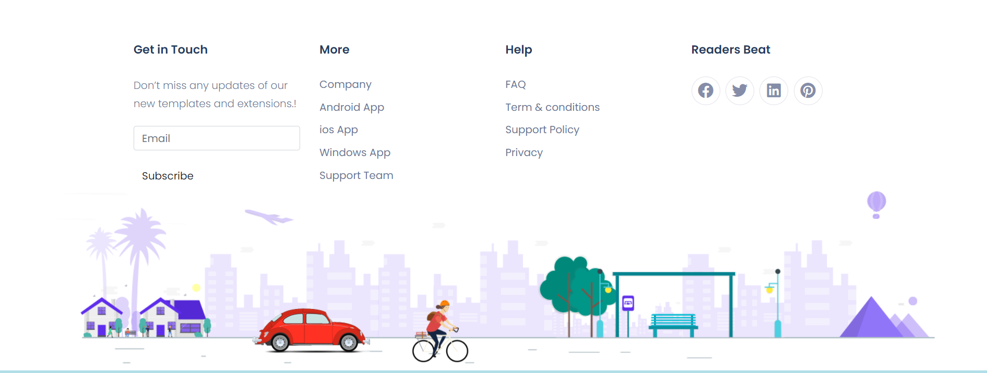
Animated footer

Slide 12
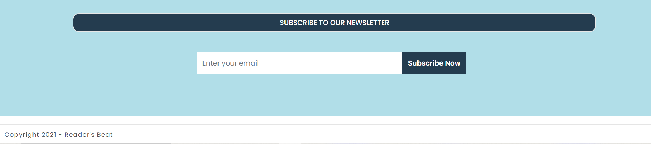
Subscribe to us !

Slide 13
2. Login
signup and contact us

Slide 14
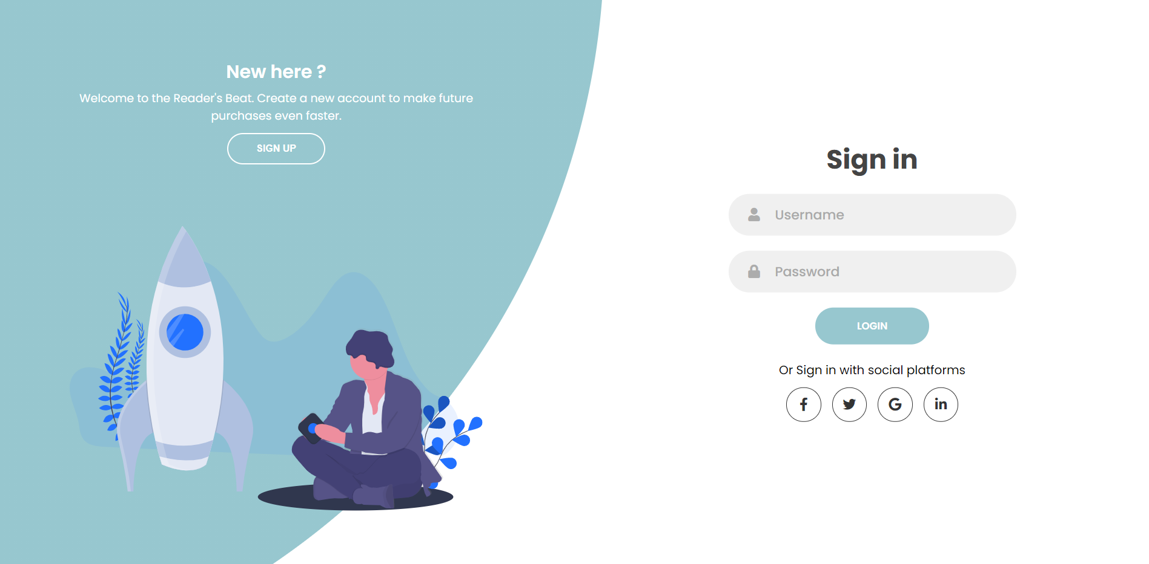
login

Slide 15
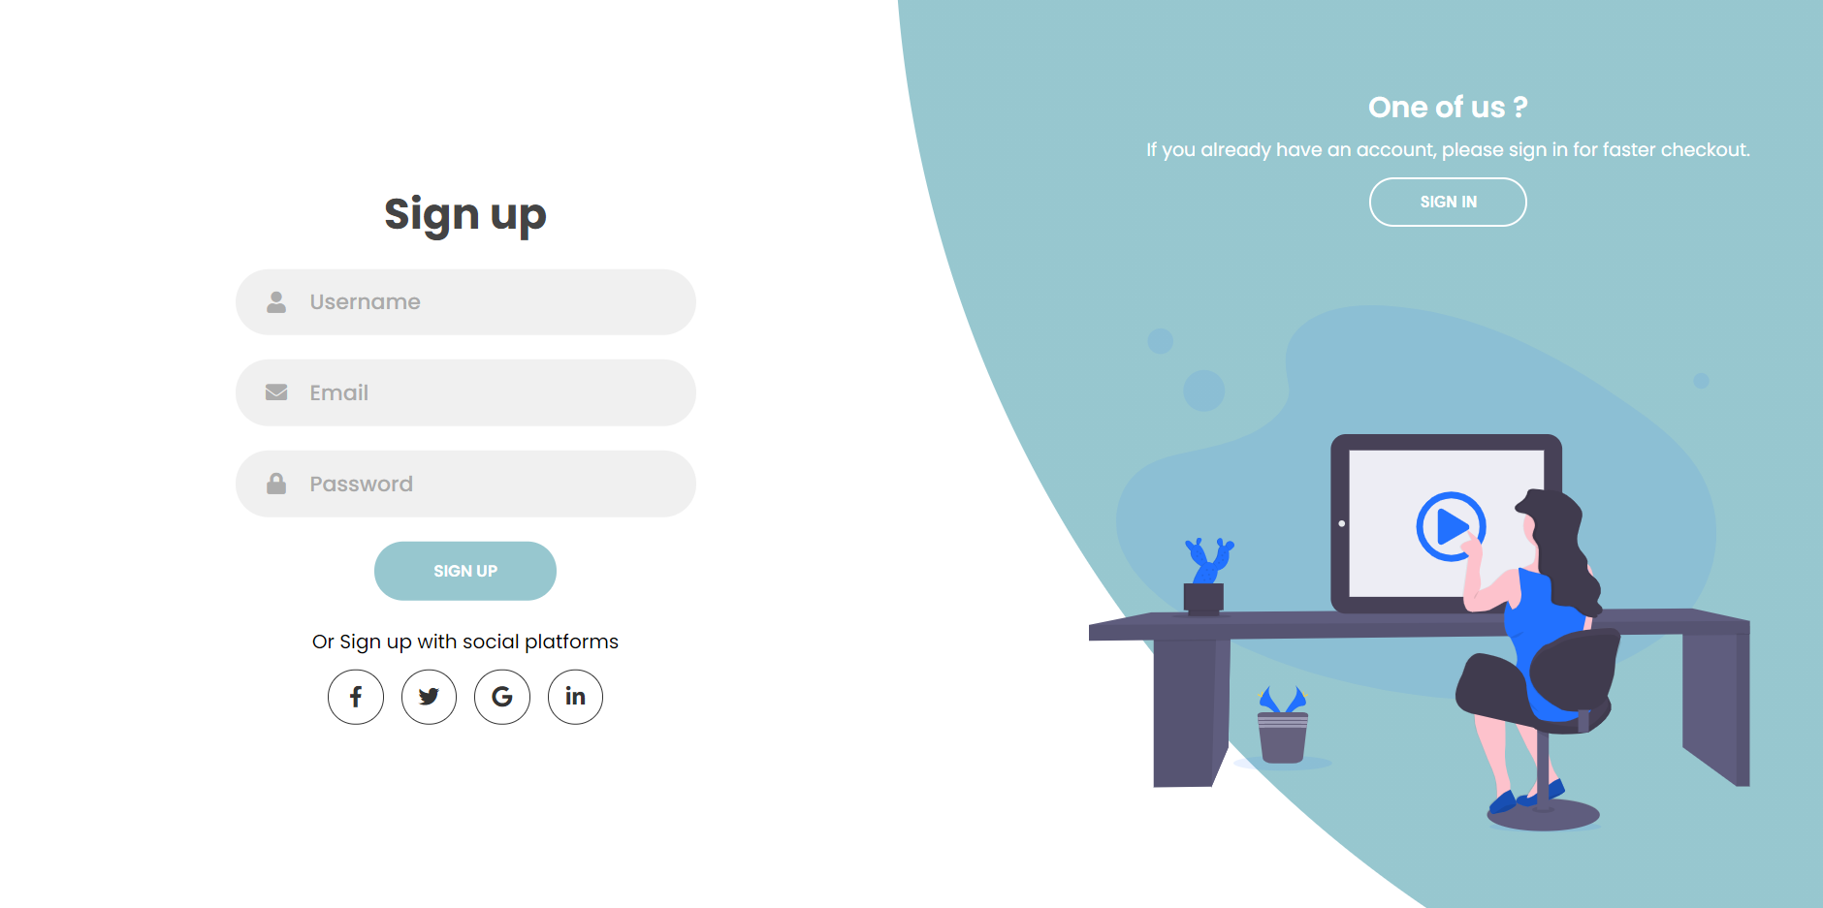
Signup

Slide 16
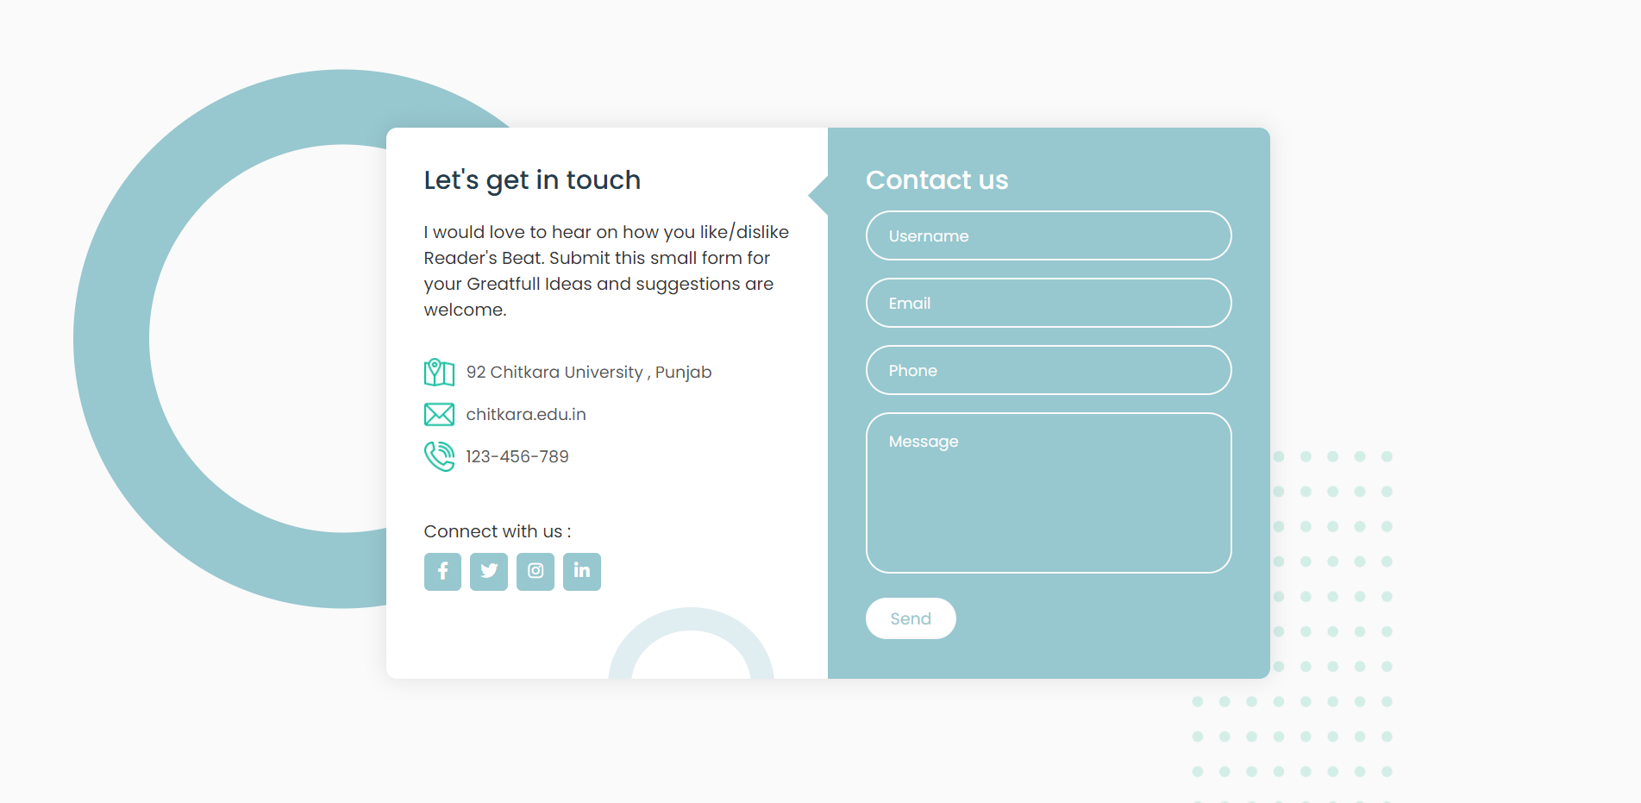
Contact us

Slide 17
#Home #categories #featured authors #buy now #about us
3. Navigation bar

Slide 18
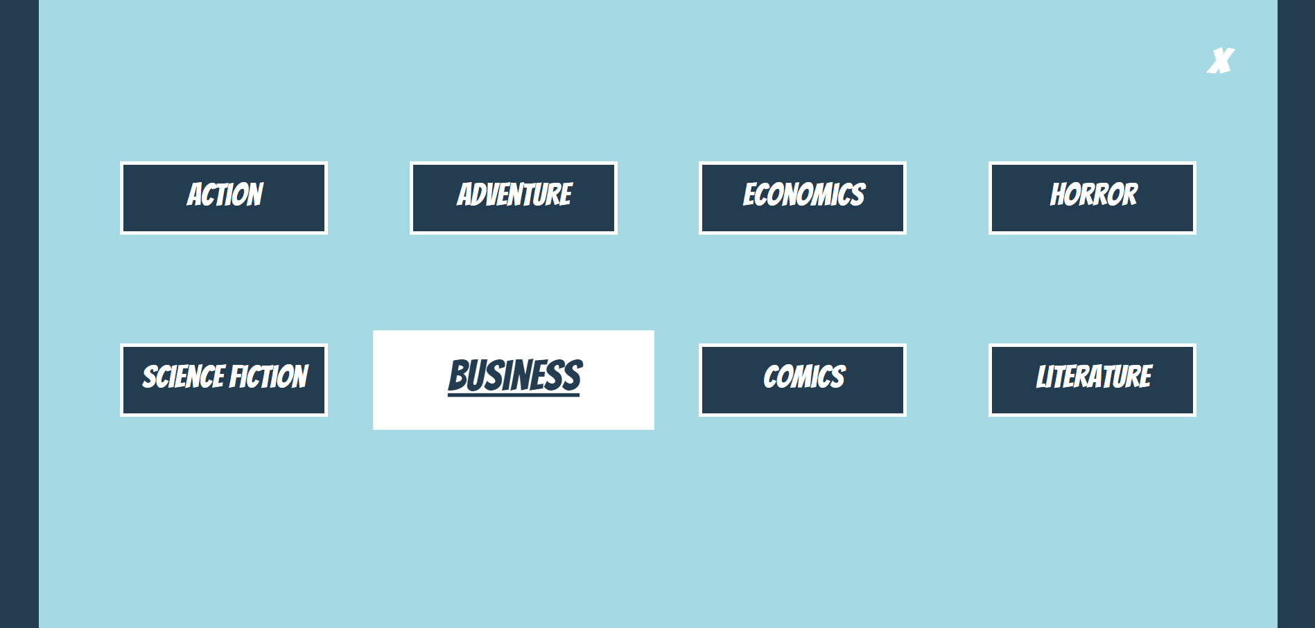
Categories

Slide 19
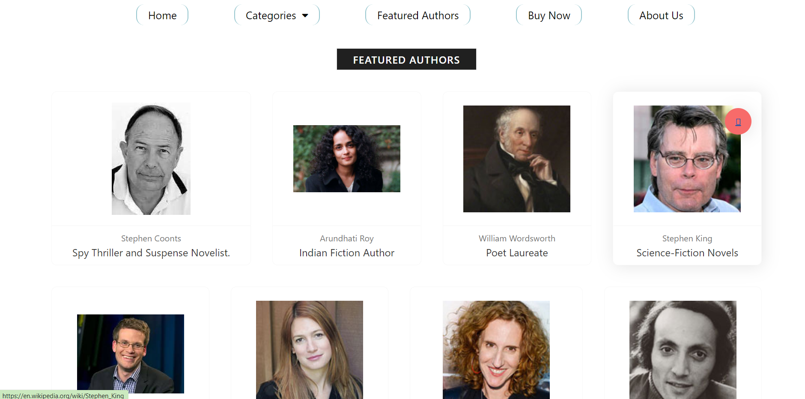
Featured authors

Slide 20
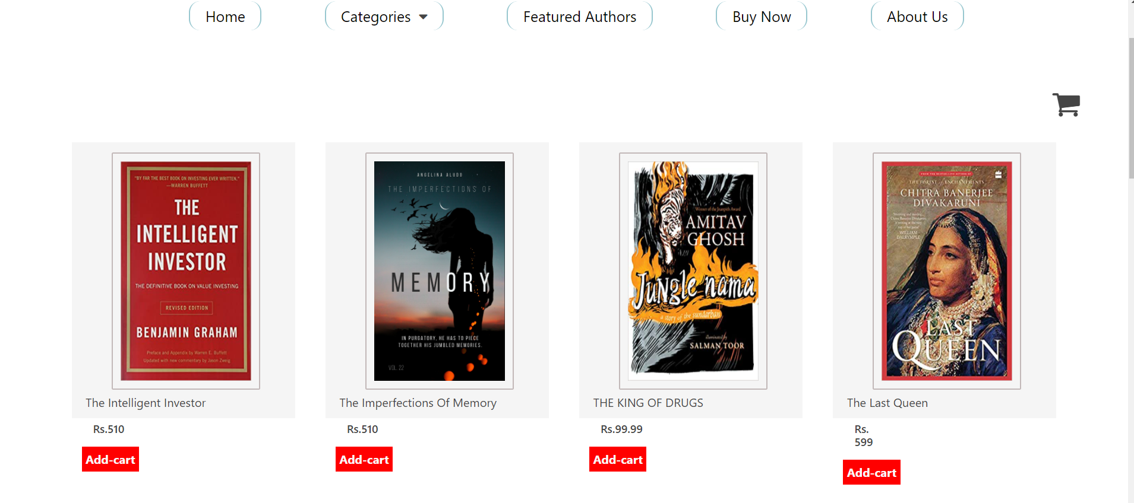
Buy now with add to cart

Slide 21
Buy now with add to cart

Slide 22

Team Presentation
Garvit Khunger
2010990990
Rohan Hooda
2010991071
Jaskaran Singh
2010991014
Pushpendra Tripathi
2010991056

Slide 23
thanks!
Any questions?

